Slide 1
DataSpark - Illuminating Insights for Global Electronics
Capstone Project – 2
By
Arangarajan Vinayagam

Slide 2
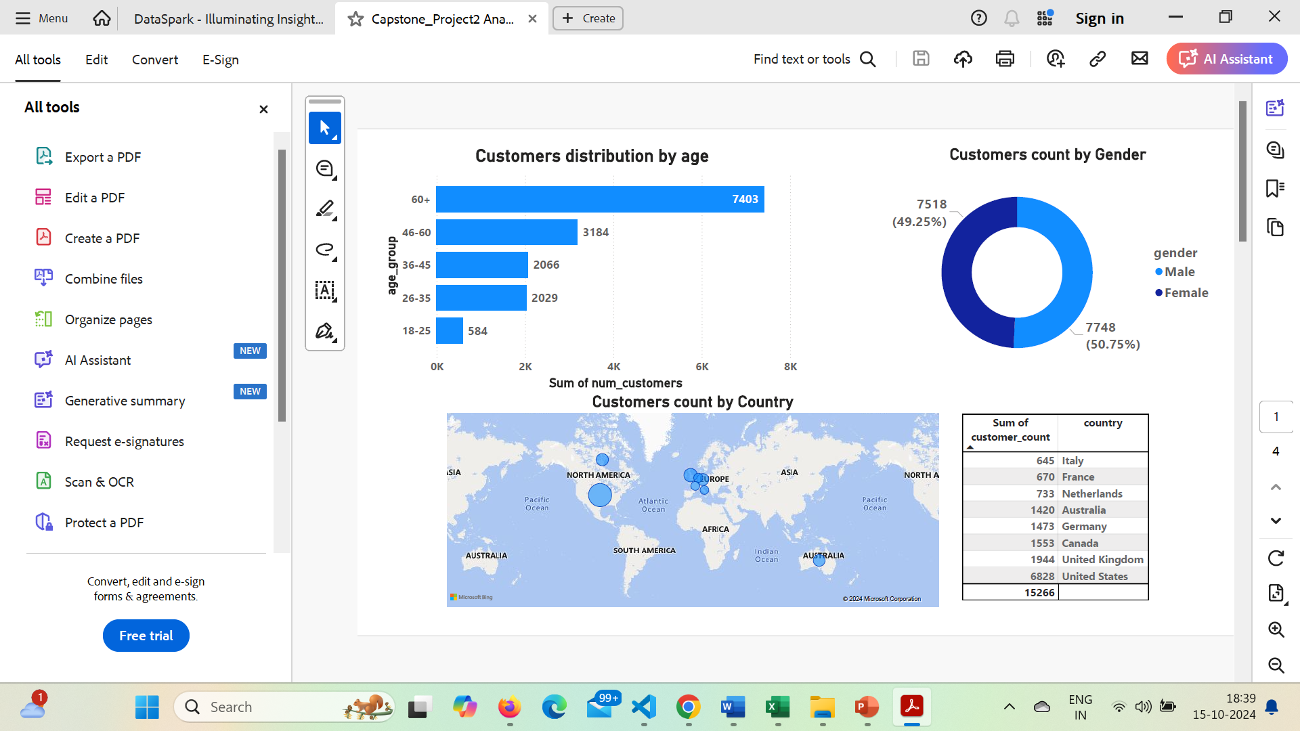
Customer Analysis
Gender Distribution:
Customers count based on Genders distribution is analysed
As compared to female customers, male customers are dominating in numbers
Age Analysis:
Using bar chart, visualization of customers are bucketed based on their age
When compared to other age groups, above 65 years are higher in counts

Slide 3

Customer Analysis
Customers Distribution by Country:
The global map was used to illustrate the location-wise analysis.
The bubble's size indicates how strong sales are in that region.
According to the country-by-country investigation, sales are highest in North America.

Slide 4
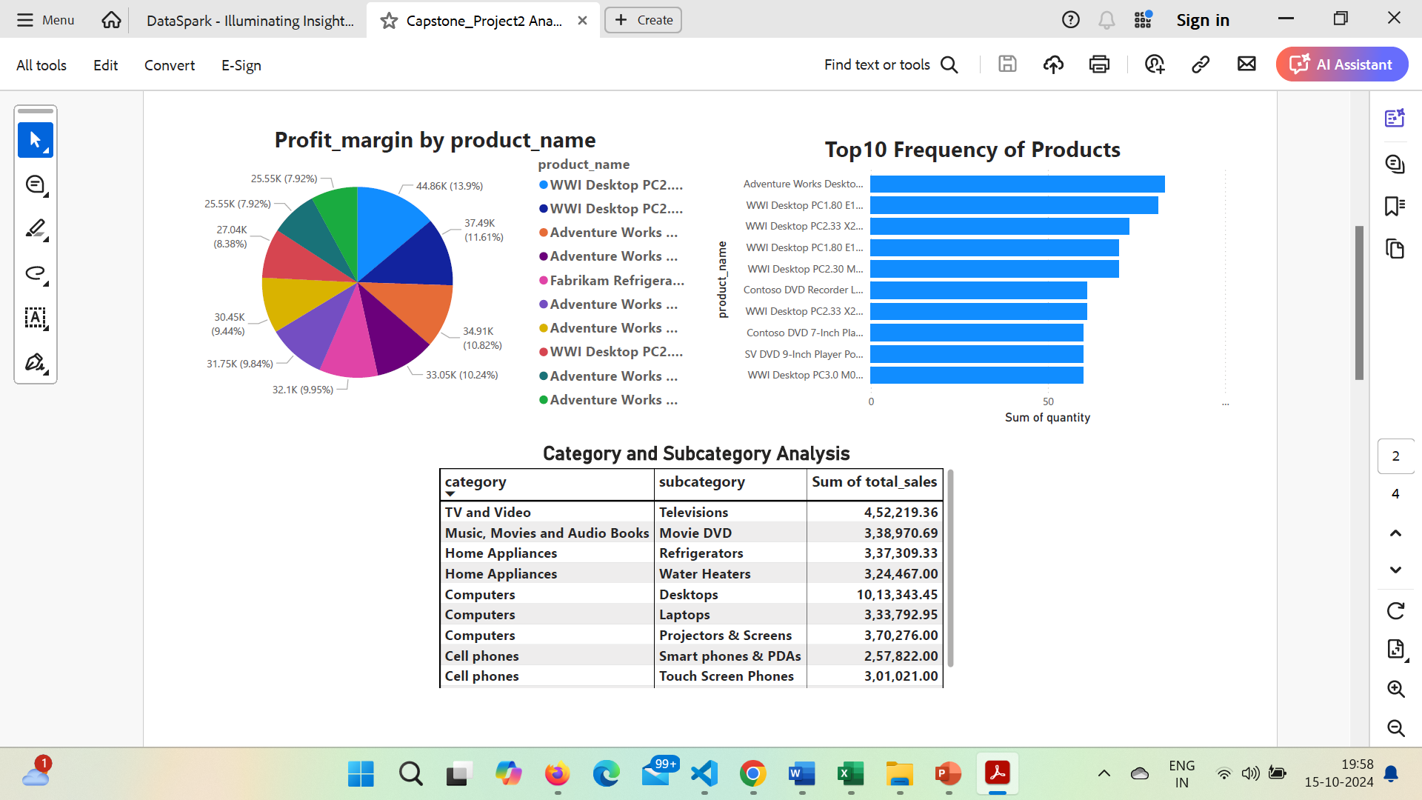
Product Analysis
Profit margin by Product:
The Pie chart clearly visualize the top product based on the profit margin.
Among top 10 products, WWI Desktop computers are dominating in profit margin.
Top 10 Frequency Products:
The top selling products are from the Desktop and computer segment.
It’s highly recommended to keep sufficient inventory to meet the customer demand.

Slide 5
Product Analysis
Product Analysis by Product Category:
Among several category of products, sub category of desktop (computers category) attains higher number of sales

Slide 6
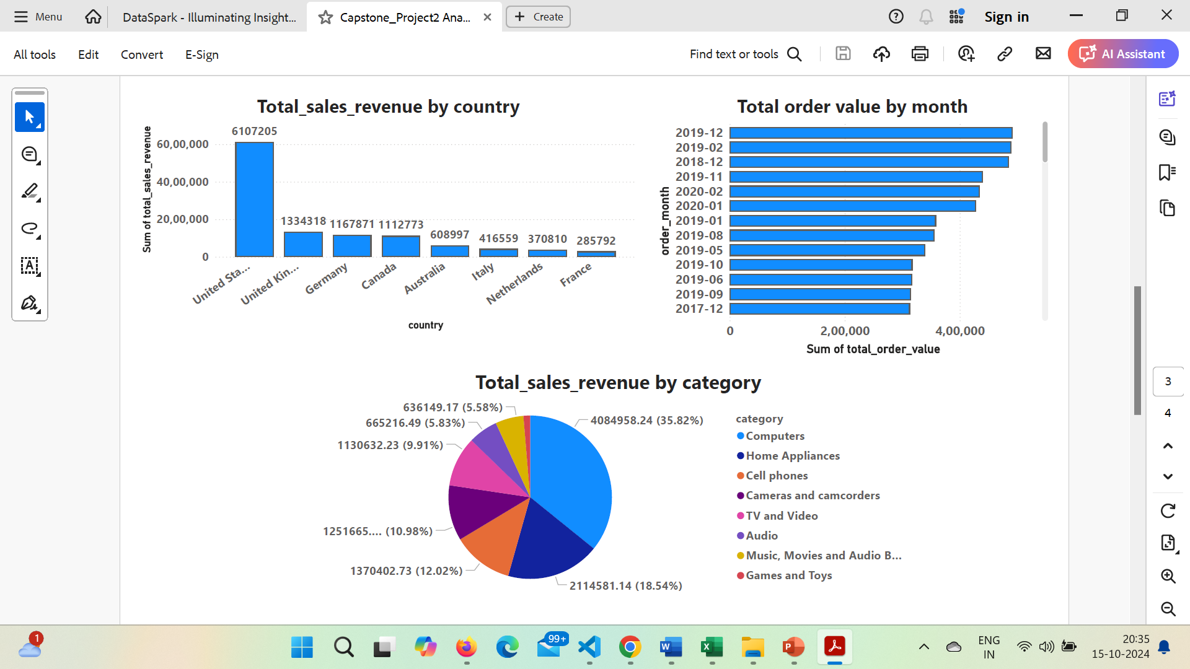
Sales Analysis
Total sales revenue by country:
Among other countries, United States attains highest sales revenue
Total sales revenue by category:
Computers category gives highest sales revenue than other products
Total order value by month:
Total order values are higher during the month of December and February in year 2019

Slide 7
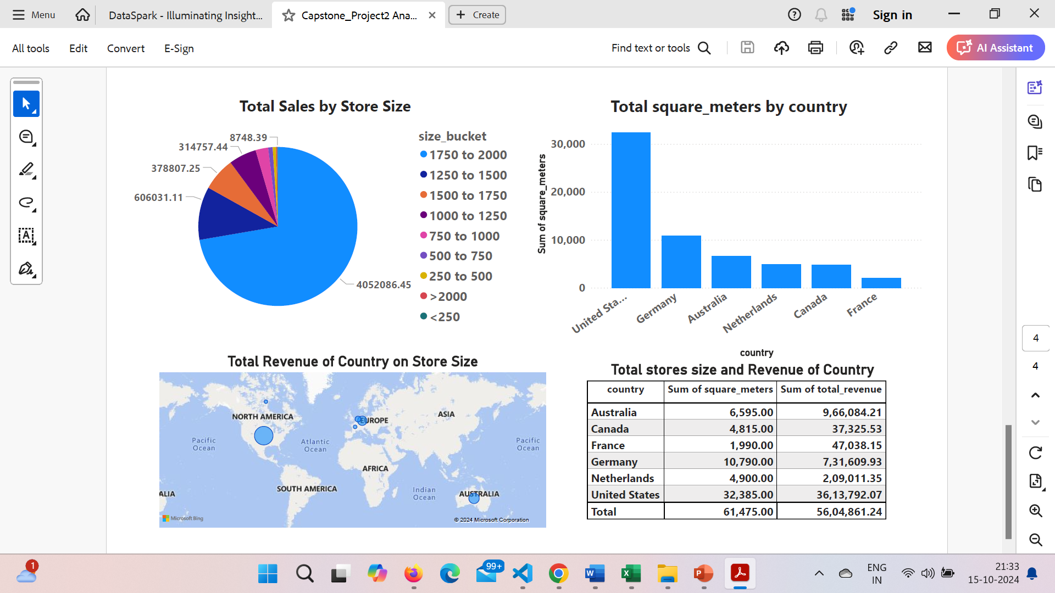
Store Analysis
Total sales by store size:
The bucket size of store area 1750 to 2000 sq.mts. attains highest sales (more than 50 % of entire sales).
Total size of Store by Country:
As per bar chart, total size of stores (sum of store sizes) are high with United States (36,13,792 sq.mts.)
Total Revenue by store size:
In Global map, North America having the highest sales revenue (larger bubble size) than other countries,

Slide 8
Thank You

